Slide 1
Top 100 Spotify
David Alfonso,
Daisy Kolosovskiy,
Miguel Garcia,
Deep Analysis throughout the years of 2010-2019
May 1st, 2023

Slide 2
Contents
01
02
03
Top Genres 2010-2014
Top Genres 2015-2019
Top artists for 2010 - 2019
Identified top music genres for 2010 - 2014
Music metrics analysis for the top genre
Identified top music genres for 2015 - 2019
Music metrics analysis for the top genre
Top downloaded artists on Spotify for 2010 - 2019
Music metrics for the top artists

Slide 3
Agenda
Spotify music metrics explained
Data collection and cleaning
Music Analysis

Slide 4

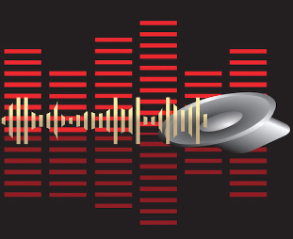






Metric Definition
Popularity: how well-known and widely-liked a particular piece of music is, such as number of
fan base.
BPM: Beats Per Minute refers to the tempo or speed of a piece of music. It is typically measured by counting the beats that occur in one minute of the song,
STRENGTHS
WEAKNESS
Duration: duration of track in seconds
Energy: intensity, excitement, and overall emotional impact of a piece of music
Dance: strong, infectious rhythm that makes you want to move your body. Features a consistent beat that is easy to follow and repetitive.
OPPORTUNITIES
THREATS

Slide 5

Section Break
Slide Title

Slide 6
Part I
Analyzing the top Genres for 2010 - 2014.
What were the top genres
Were there any metrics that set the top genre apart

Slide 7
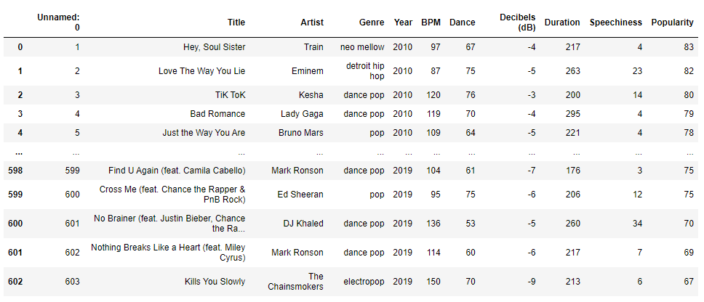
Spotify Top 100 songs of 2010 - 2019
(https://www.kaggle.com/datasets/muhmores/spotify-top-100-songs-of-20152019) by: Michael Morris
f

Slide 8
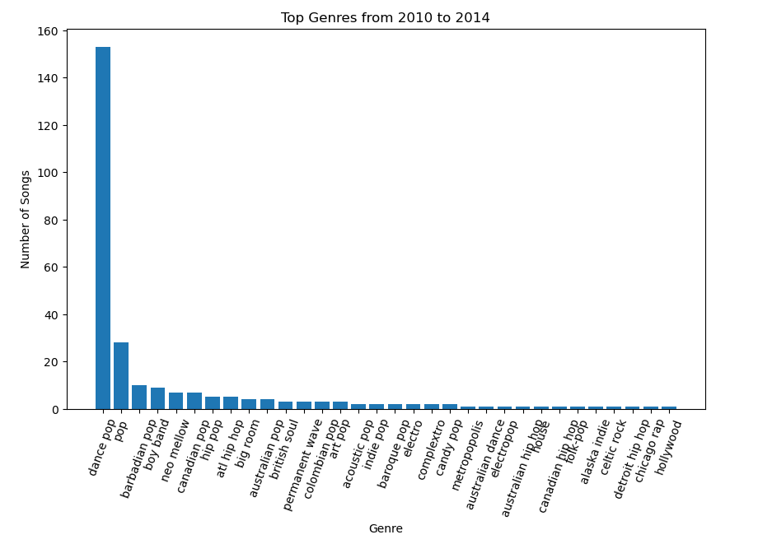
Genres by Spotify download 2010-2014

Slide 9
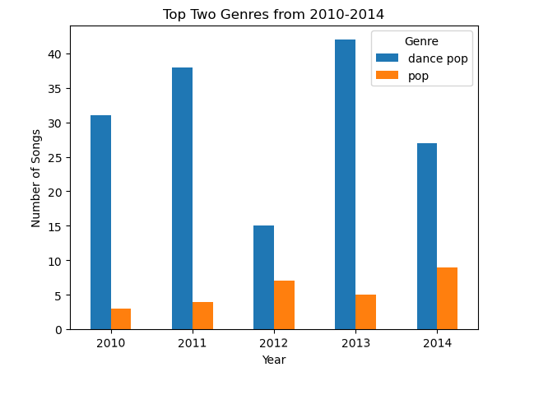
Top Genres from 2010-2014

Slide 10
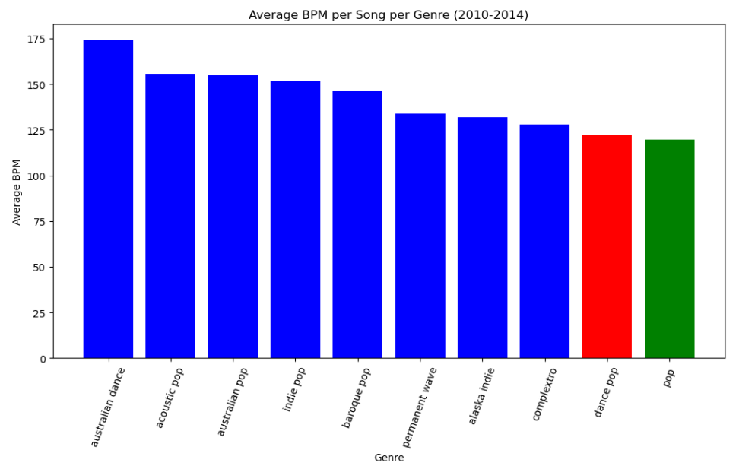
Average BPM per song per Genre

Slide 11
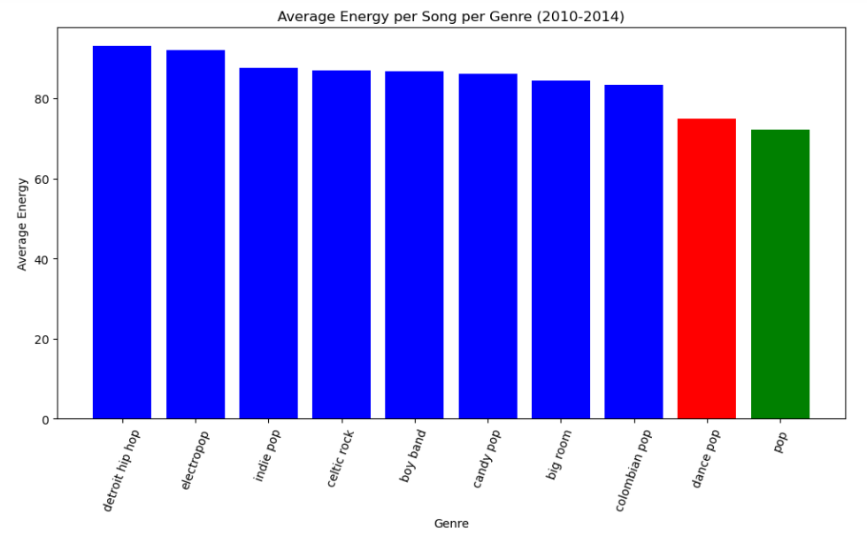
Average Energy per Song per Genre

Slide 12
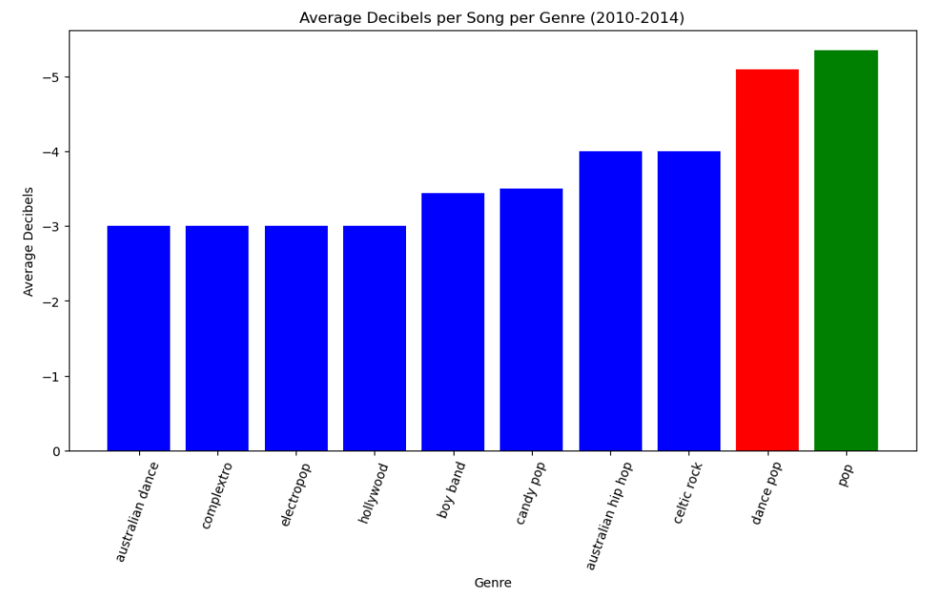
Average Decibals per Song per Genre 2010-2014

Slide 13
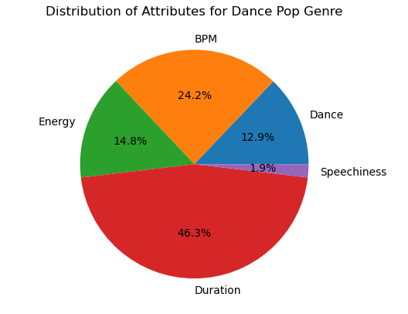
Distribution of Attributes for Dance Pop Genre 2010-2014

Slide 14
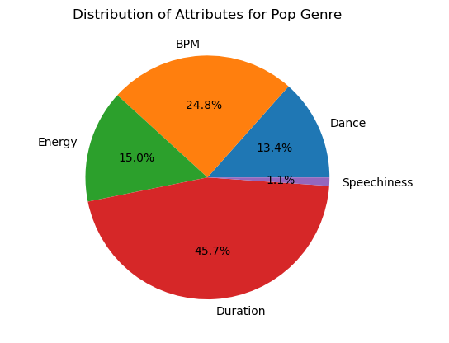
Distribution of Attributes Pop Genre 2010-2014

Slide 15
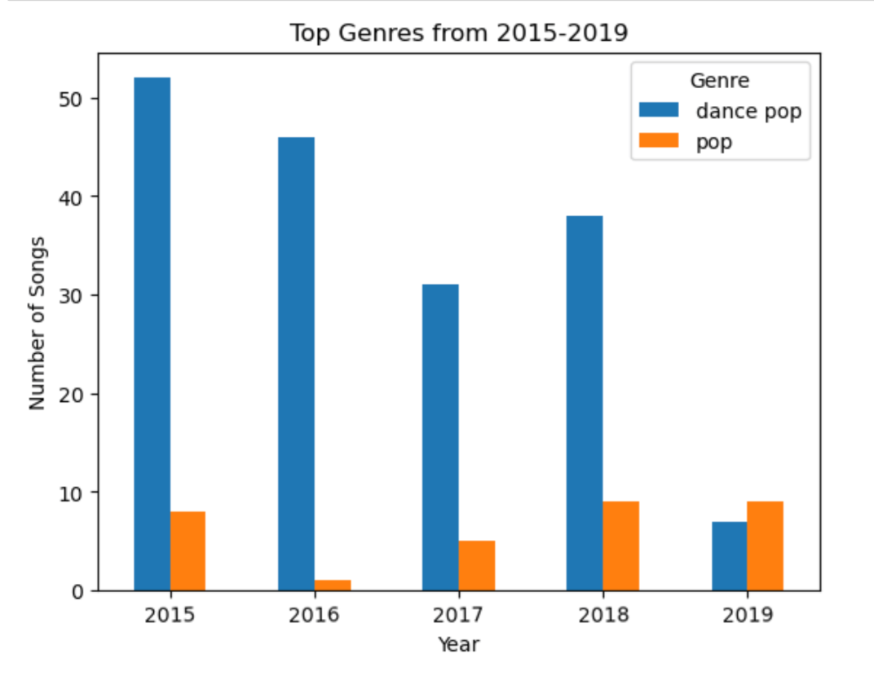

Slide 16
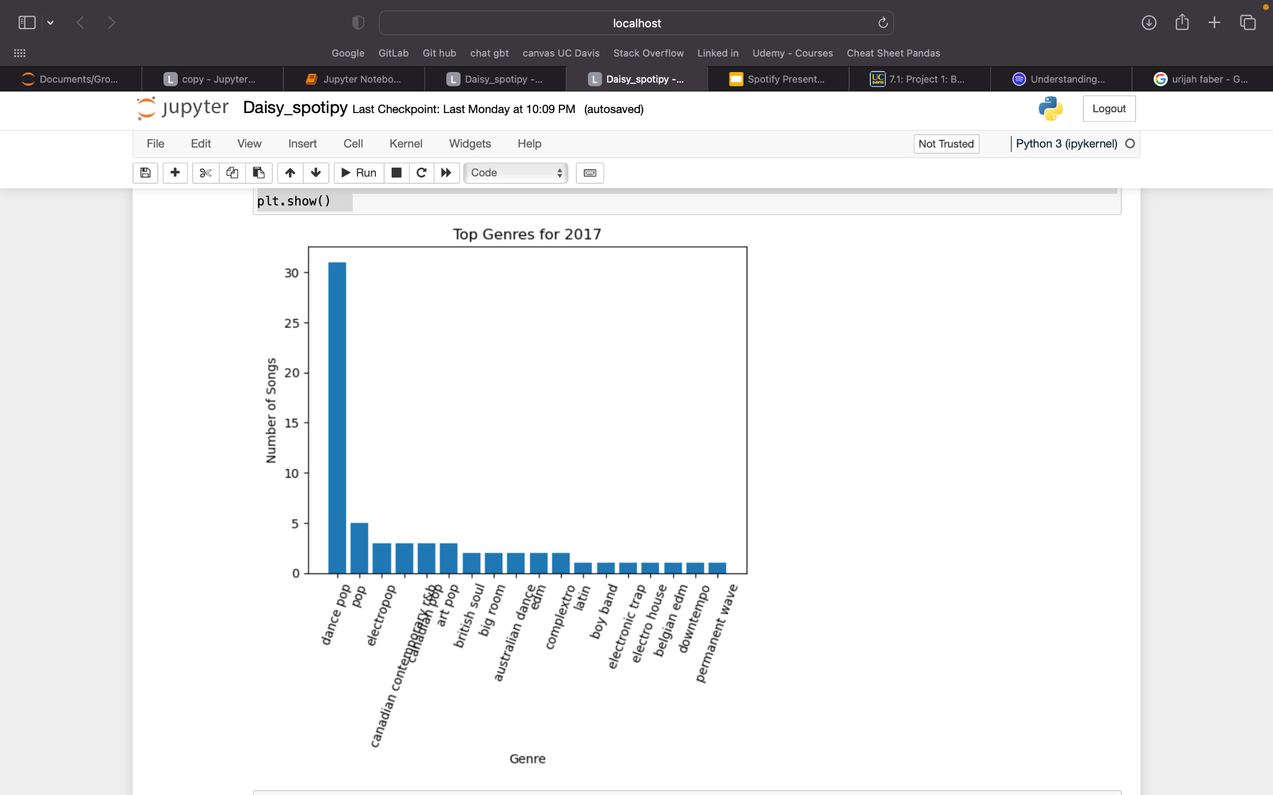
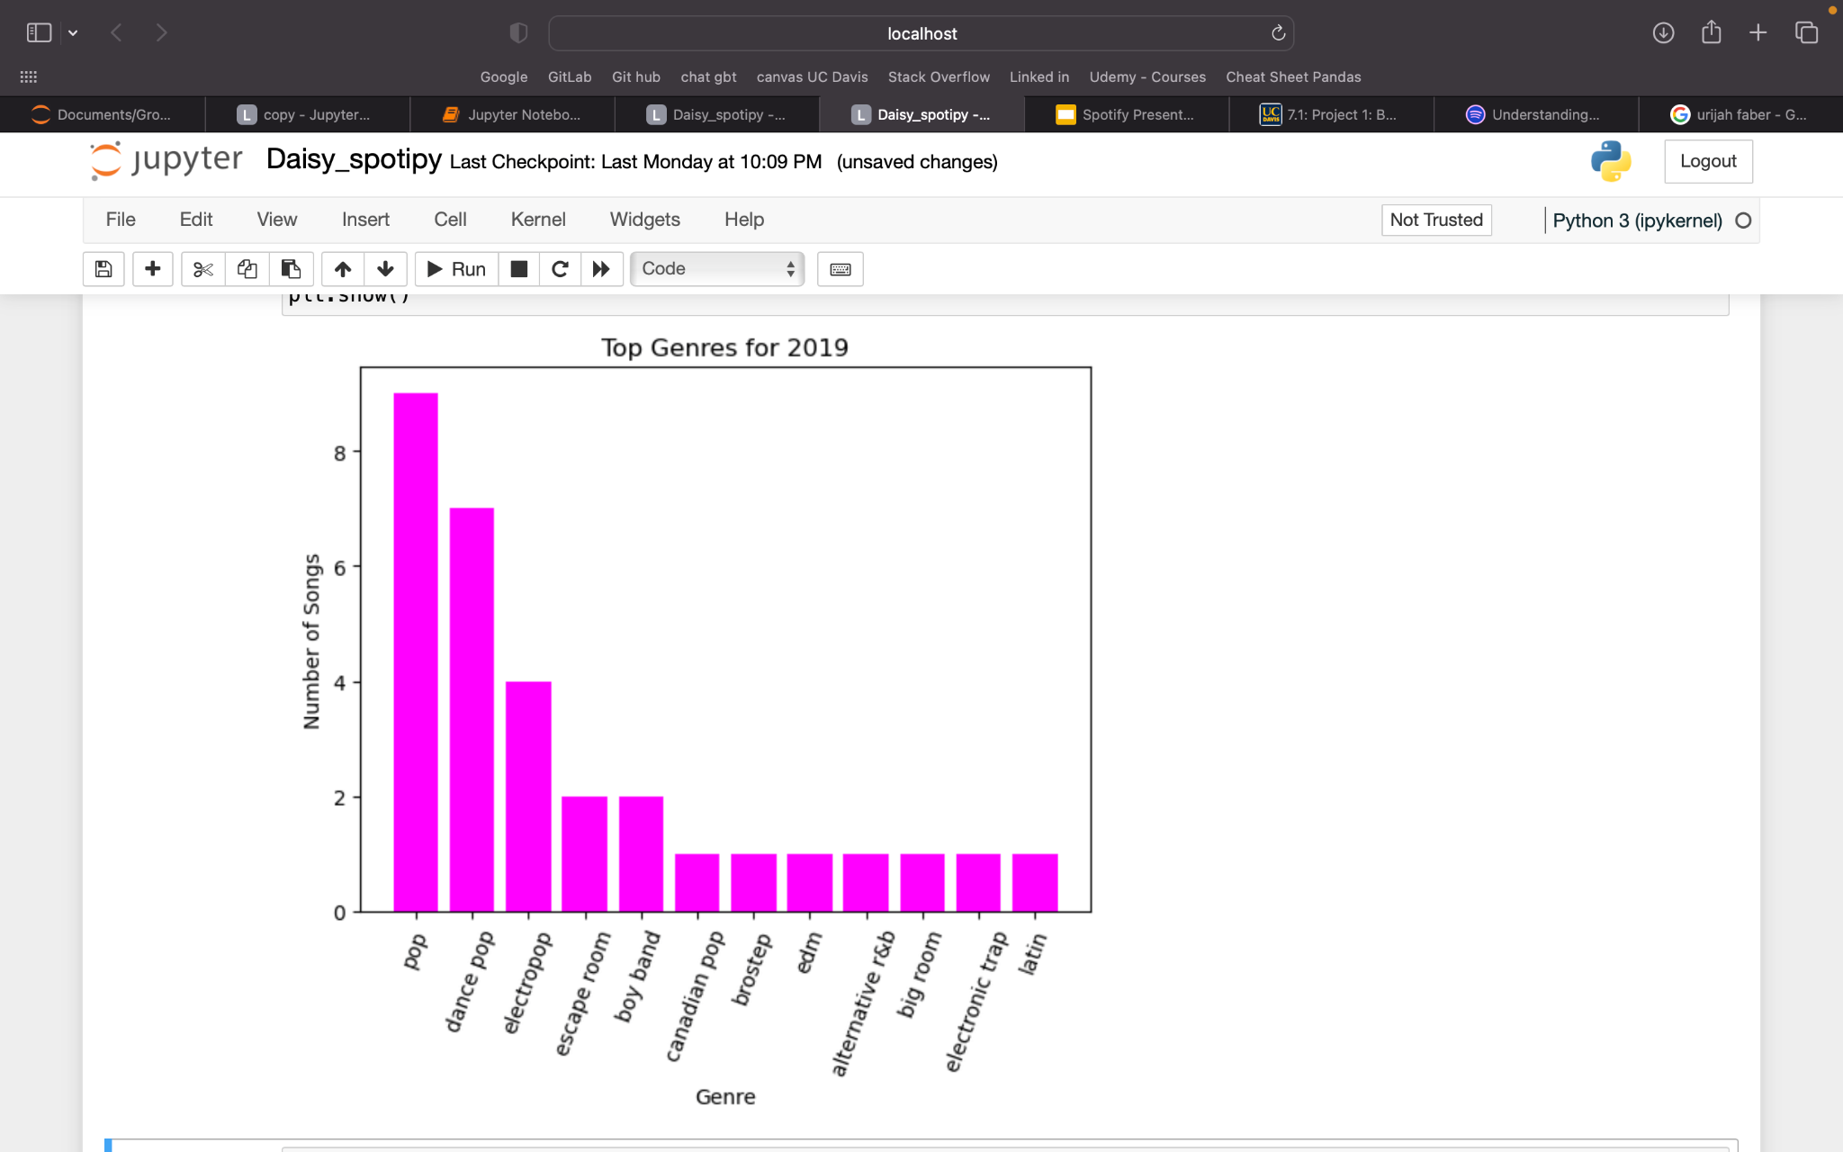
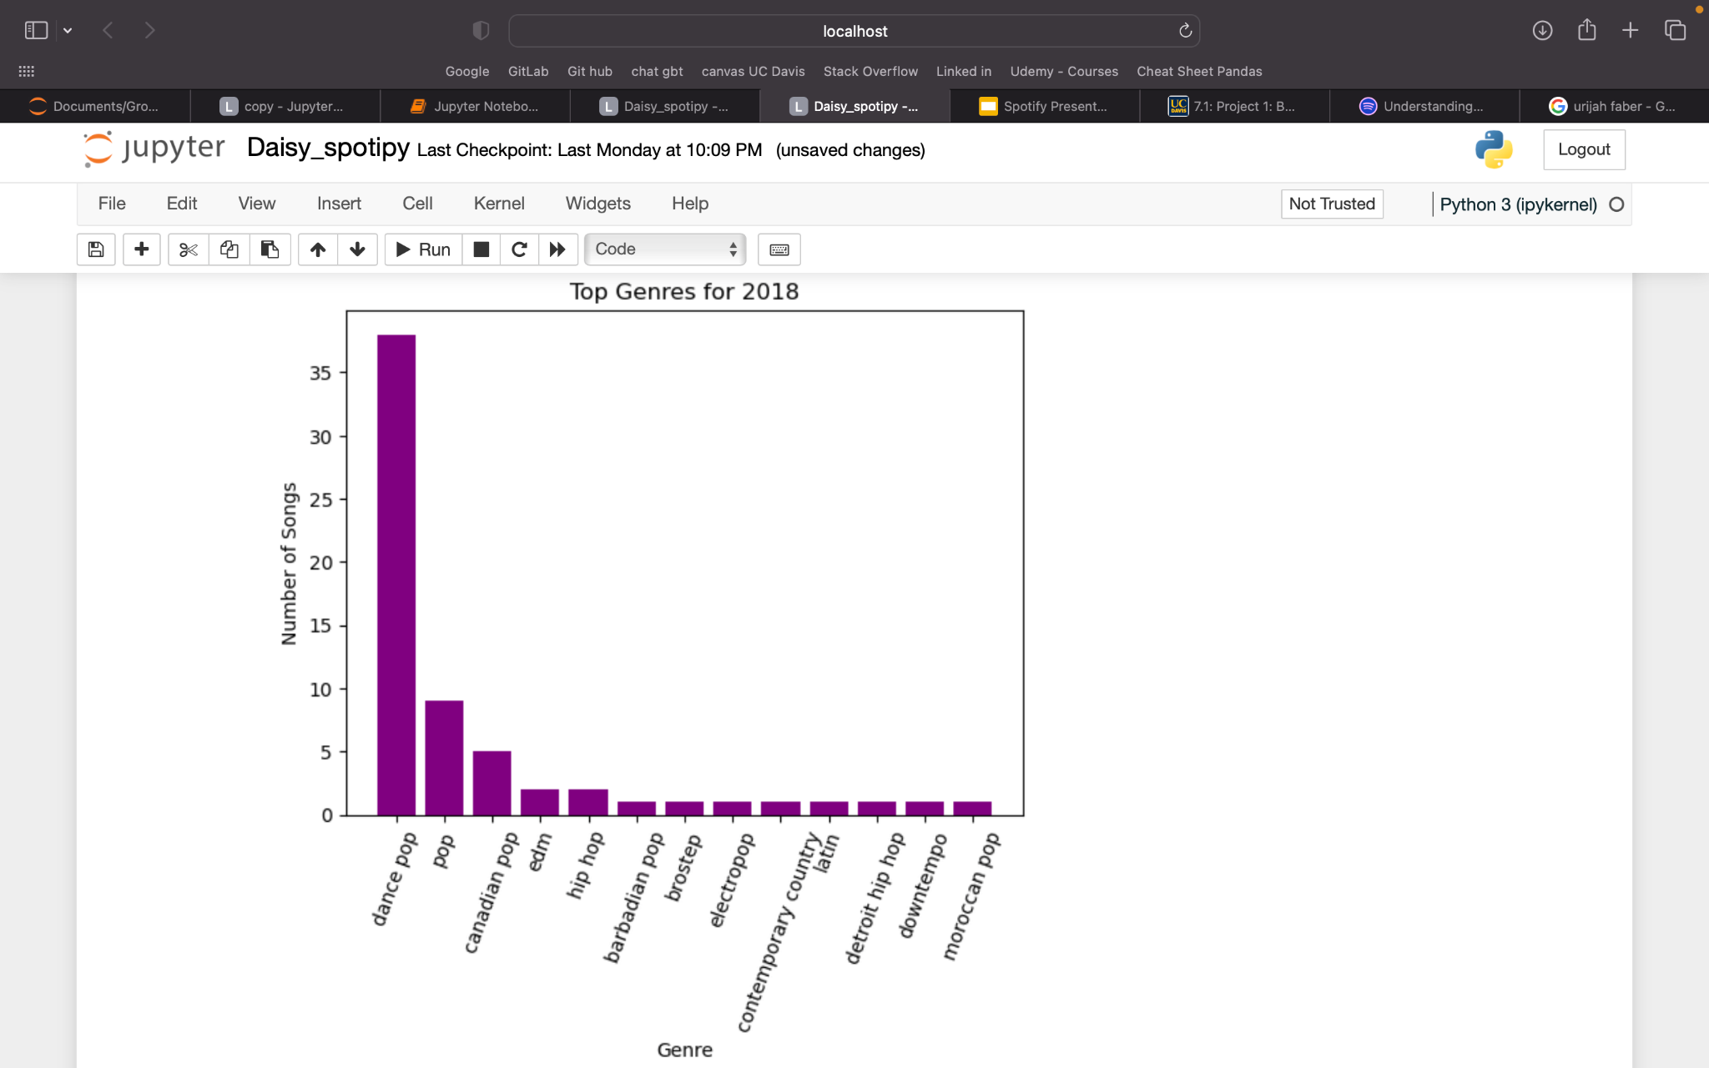
Biggest differences

Slide 17
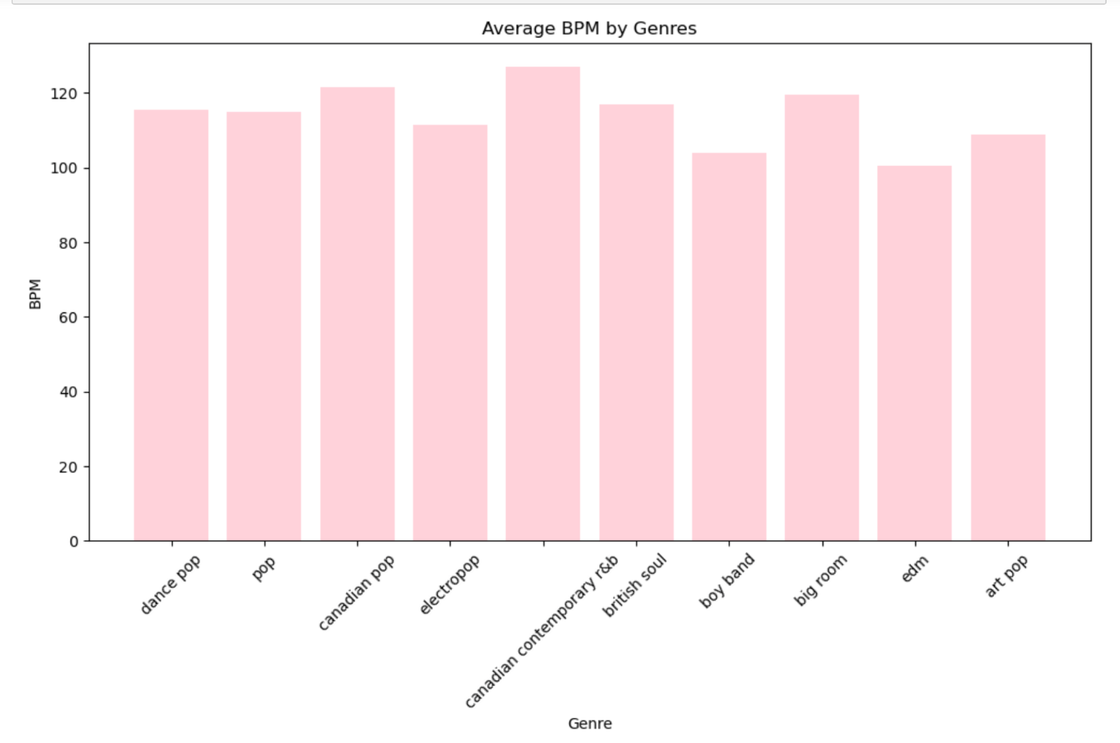
Average BPM by Genres from 2015-2019
Dance pop & Pop both in range of ~115 BPM
Lowest BPM Genre: EDM ~100 BPM
Highest BPM Genre: Canadian Contemporary R&B ~ 125 BPM
Most common BPM ranged between ~100 to ~125 BPM

Slide 18
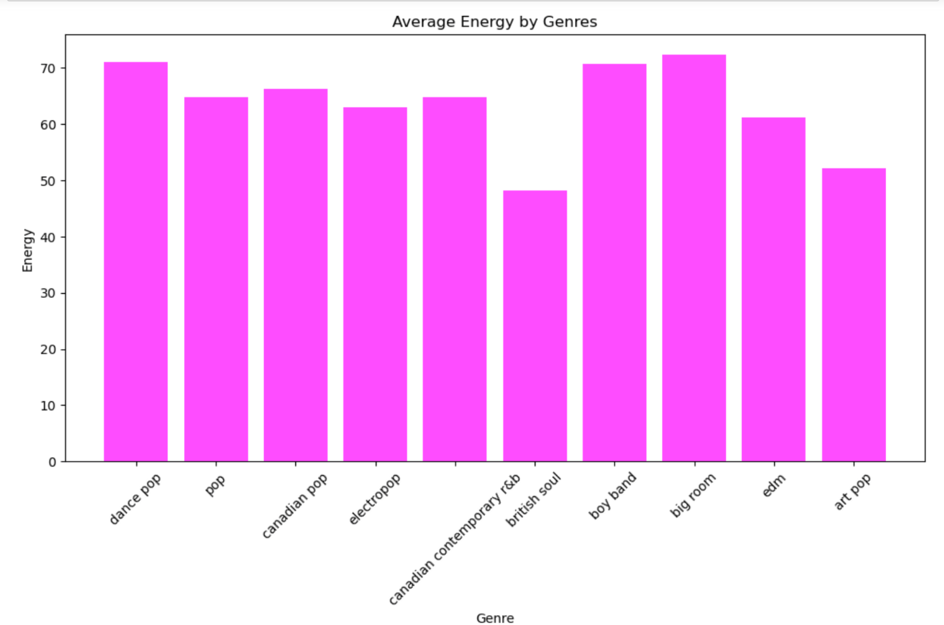
Average Energy by Genre from 2015-2019
Dance pop and pop had different average energy levels by ~5 levels
Lowest Average Energy Genre: British Soul, ~47 level
Highest Average Energy Genre: Big Room, ~72
Most Common Average Energy average: ~60 to ~75

Slide 19
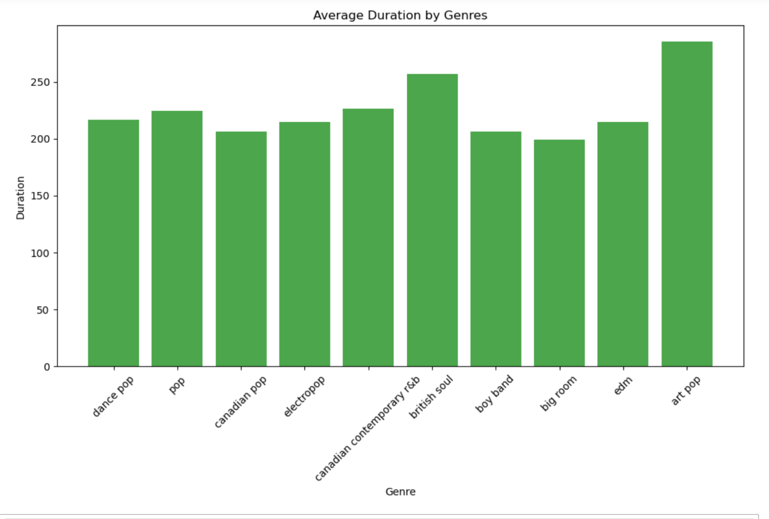
Average Duration by Genres from 2015 - 2019
Dance pop and Pop between 210 - 230 seconds
Highest Genre:
Art Pop, ~300 seconds
Lowest Genre:
Big Room, ~190 seconds
Most Common Duration: ~190 to ~230 seconds

Slide 20
Part III
Top artists for 2010 - 2019
Top downloaded artists on Spotify for 2010 - 2019
Music metrics for the top artists

Slide 21
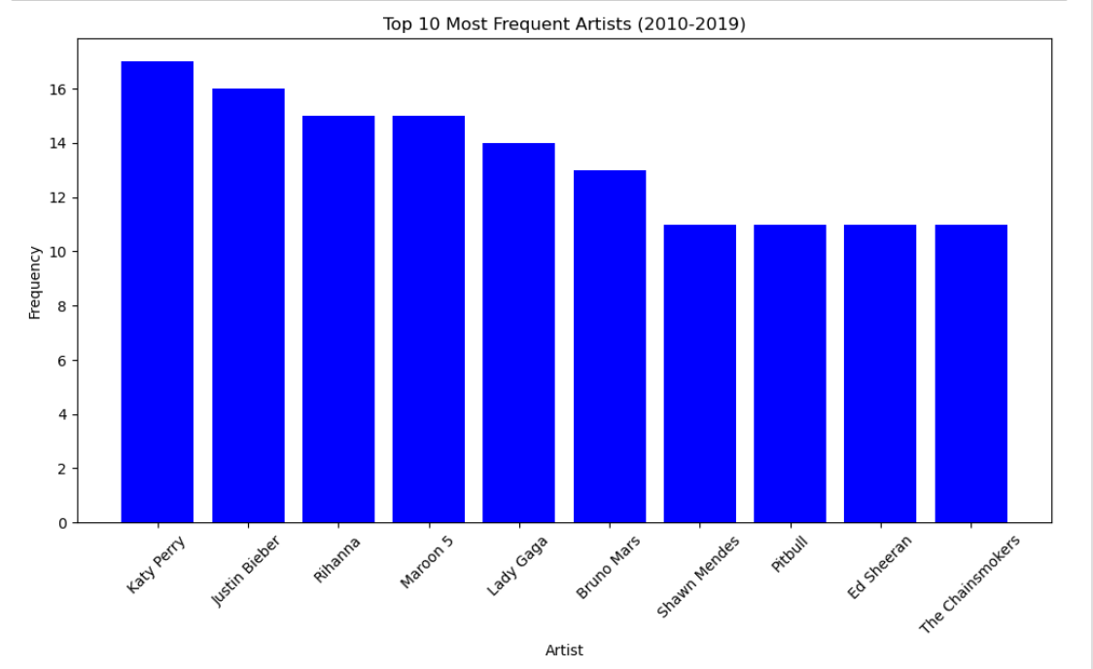
Top 10 Most Frequent Artists

Slide 22
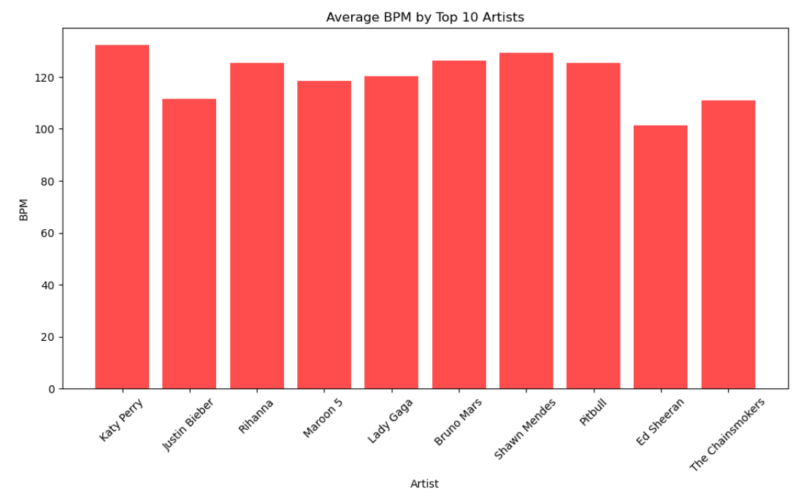
Average BPM by Top 10 Artists

Slide 23
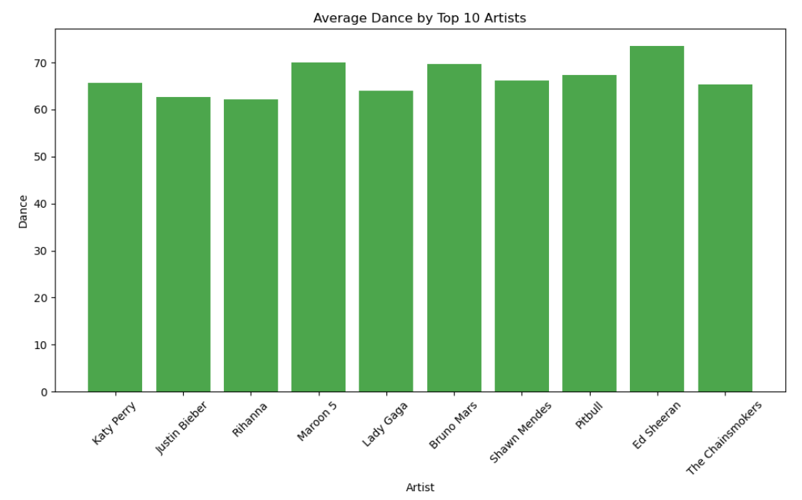
Average Dance by Top 10 Artists

Slide 24
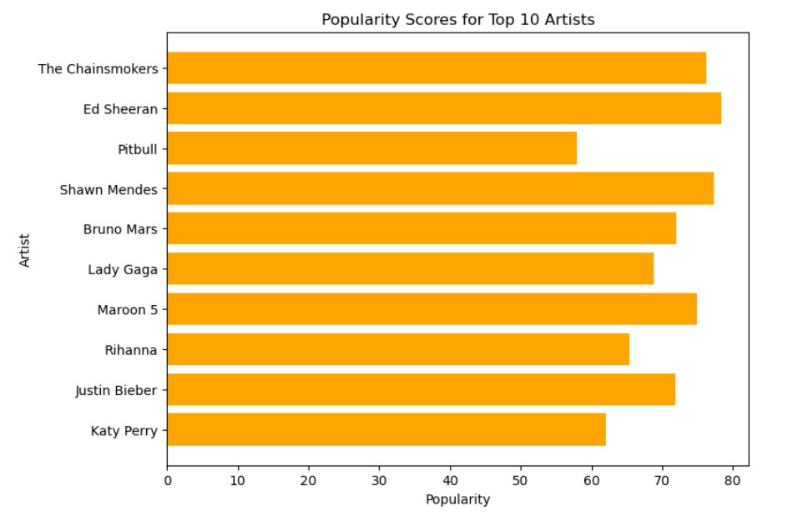
Popularity Scores for Top 10 Artists

Slide 25
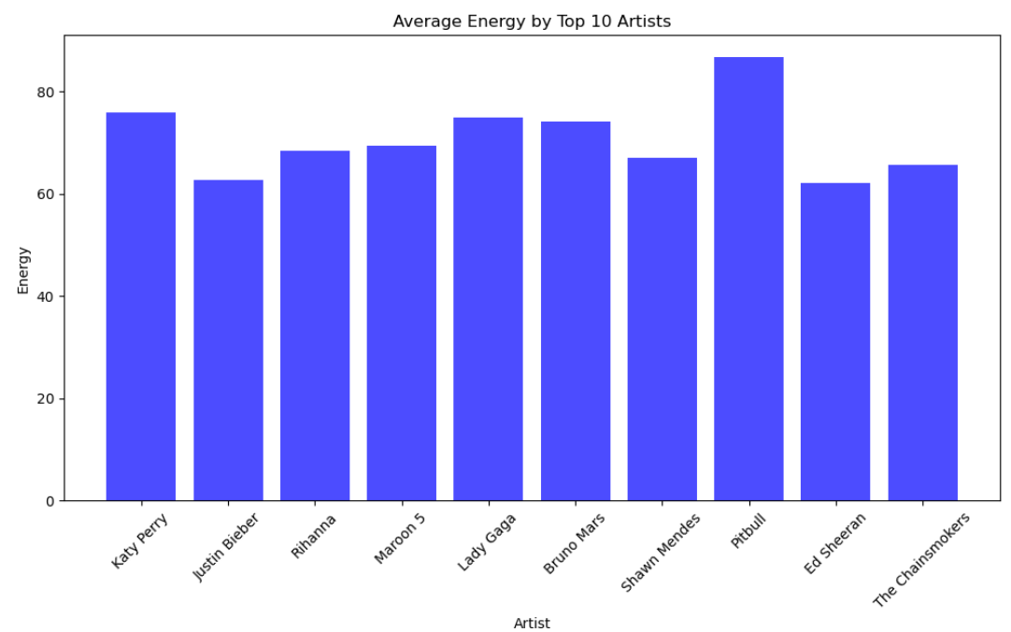
Average Energy by Top 10 Artists

Slide 26
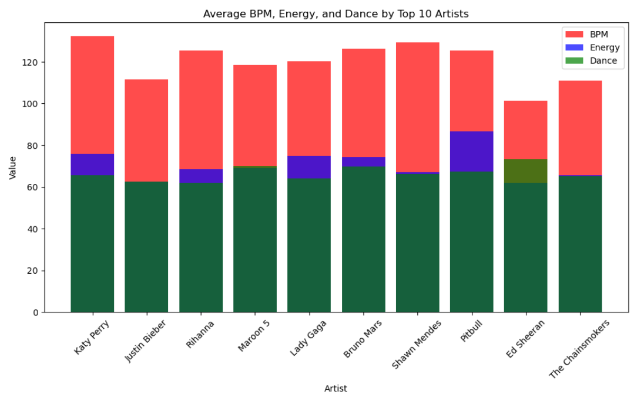
Average BPM, Energy, and Dance

Slide 27
CONCLUSIONS:
Based on analysis of music metrics we were unable to find any discernible difference that set the top genre apart from the rest
If you want to be in the top spot of Spotify downloads, be the next Katy Perry by having even metrics throughout your music to ensure longevity within the Top 100 spots

Slide 28


Quote by top artist!
“Comparisons are easily done, once you’ve had a taste of perfection.”
- Katy Perry

Slide 29
Thanks !

